Slide 1
ECG ARRYTHMIA Classification using IBM Watson studio
Developed by : BHARATH
VEEREN
HARSHITA
SOWMYA
SRIYA

Slide 2
Introduction
What is arrhythmia?
An arrhythmia is a problem with the rate or rhythm of the heartbeat. During an arrhythmia, the heart can beat too fast, too slowly, or with an irregular rhythm.
The most common test used to diagnose an arrhythmia is an electrocardiogram (ECG).

Slide 3
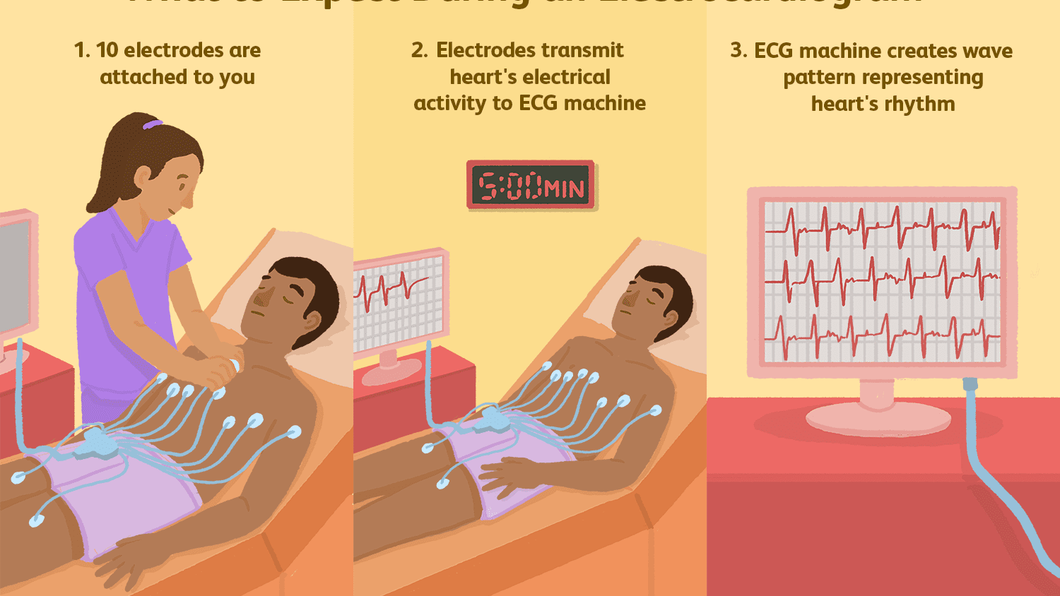
What is an ECG?
An ECG records these impulses to show how fast the heart is beating, the rhythm of the heart beats (steady or irregular), and the strength and timing of the electrical impulses as they move through the different parts of the heart. Changes in an ECG can be a sign of many heart-related conditions

Slide 4
According to the World Health Organization (WHO), cardiovascular diseases
(CVDs) are the number one cause of death today. Over 17.7 million people died from
CVDs in the year 2017 all over the world which is about 31% of all deaths, and over
75% of these deaths occur in low and middle income countries. Arrhythmia is a
representative type of CVD that refers to any irregular change from the normal heart
rhythms. There are several types of arrhythmia including Left bundle branch block, Premature atrial contraction, Premature Ventricular contraction, Right bundle branch block and Ventricular fibrillation. Although single arrhythmia heartbeat may not have a serious impact on life, continuous arrhythmia beats can result in fatal circumstances.Thus, it is important to periodically monitor the heart rhythms to manage and prevent the CVDs. Electrocardiogram (ECG) is a non-invasive medical tool that displays the rhythm and status of the heart. Therefore, automatic detection of irregular heart rhythms from ECG signals is a significant task in the field of cardiology.

Slide 5
Objectives
Classification of electrocardiogram (ECG) signals plays an important role in clinical diagnosis of heart disease. Our Project proposes the design of an efficient system for classification of the Left bundle branch block,Normal beat, Premature atrial contraction, Premature Ventricular contraction, Right bundle branch block and Ventricular fibrillation using a Convolution Neural Networks.
Our aim from the project is to make use of keras to extract the libraries for machine learning .The aim of this research was to detect features for accurate images comparison.
Secondly, to learn how to work with image processing techniques and , we develop a model which can tell us type of ECG Arrhythmia . The objective is achieved through applying CNN
In the end, The model the deployed using IBM Watson studio and is made available for the end user

Slide 6
Image pre processing
Image processing is divided into analogue image processing and digital image processing. Digital image processing is the use of computer algorithms to perform image processing on digital images. As a subfield of digital signal processing, digital image processing has many advantages over analogue image processing. It allows a much wider range of algorithms to be applied to the input data — the aim of digital image processing is to improve the image data (features) by suppressing unwanted distortions and/or enhancement of some important image features so that our AI-Computer Vision models can benefit from this improved data to work on. An image is nothing more than a two-dimensional array of numbers(or pixels) ranging between 0 and 255. It is defined by the mathematical function f(x,y) where x and y are the two co-ordinates horizontally and vertically.The value of f(x,y) at any point is giving the pixel value at that point of an image.

Slide 7
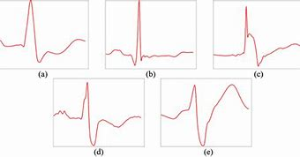
ECG IMAGE PREPROCESSING

Slide 8
Model building
In this phase data science team needs to develop data sets for training, testing, and production purposes. These data sets enable data scientist to develop analytical method and train it, while holding aside some of data for testing the model.
Team develops datasets for testing, training, and production purposes. In addition, in this phase, the team builds and executes models based on work done in the model planning phase. The team also considers whether its existing tools will suffice for running the models, or if it will need more robust environment for executing models and workflows (Example – fast hardware and parallel processing)
In this project we use python for model building

Slide 9
Application building
In this project we make use of Flask because Flask is a web framework. This means flask provides you with tools, libraries and technologies that allow you to build a web application. This web application can be some web pages, a blog, a wiki or go as big as a web-based calendar application or a commercial website.
Flask is part of the categories of the micro-framework. Micro-framework are normally framework with little to no dependencies to external libraries. This has pros and cons. Pros would be that the framework is light, there are little dependency to update and watch for security bugs, cons is that some time you will have to do more work by yourself or increase yourself the list of dependencies by adding plugins.

Slide 10
Ibm deployment
IBM Watson Studio empowers data scientists, developers and analysts to optimize decisions anywhere on IBM Cloud Pak for Data. Unite teams, automate AI lifecycles and speed time to value on an open multicloud architecture. Bring together open source frameworks like PyTorch, TensorFlow and scikit-learn with IBM and its ecosystem tools for code-based and visual data science. Work with Jupyter notebooks, JupyterLab and CLIs — or in languages such as Python, R and Scala.

Slide 11
Conclusion
In this paper, we proposed an ECG arrhythmia classification method based on deep learning techniques. ECG signals, belonging to six different types, were obtained from the dataset. The ECG signals were segmented into 6 types accordingly. 15,341 records were selected for ECG classification.
In the procedure of the proposed method,The ECG spectrograms were used as input to the proposed method. The ECG arrhythmia was identified and classified using the CNN. We have performed a thorough experiment using Arrhythmia Dataset which was provided. Our obtained detection accuracy is 96%, which is better than existing methods.

Slide 12
THANK YOU

